Slide 1

Integration Testing
CSE430 – Software Testing and Quality Assurance
Instructor:
Prof. Dr. Shamim H Ripon

Slide 2

Outline
Integration Testing Overview
Integration Testing Guideline
Integration Testing Techniques
Examples

Slide 3
Overview

Slide 4
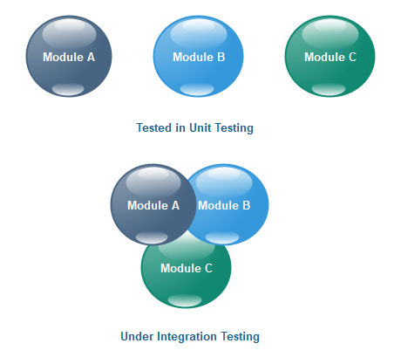
Integration testing is the second level of the software testing process comes after unit testing.
In this testing, units or individual components of the software are tested in a group.
The focus of the integration testing level is to expose defects at the time of interaction between integrated components or units.

Slide 5
Unit testing uses modules for testing purpose, and these modules are combined and tested in integration testing.
The Software is developed with a number of software modules that are coded by different coders or programmers.
The goal of integration testing is to check the correctness of communication among all the modules.
Once all the components or modules are working independently, then we need to check the data flow between the dependent modules is known as integration testing.

Slide 6
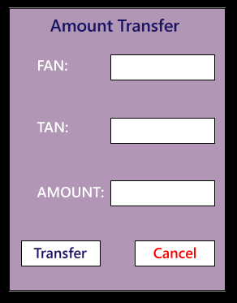
One sample example of a banking application
First, we will login as a user P to amount transfer and send Tk. 200, the confirmation message should be displayed on the screen as amount transfer successfully.
Now logout as P and login as user Q and go to amount balance page and check for a balance in that account = Present balance + Received Balance. Therefore, the integration test is successful.
Also, we check if the amount of balance has reduced by Tk.200 in P user account.
Click on the transaction, in P and Q, the message should be displayed regarding the data and time of the amount transfer.

Slide 7
Guidelines for Integration Testing

Slide 8
We go for the integration testing only after the functional testing is completed on each module of the application.
We always do integration testing by picking module by module so that a proper sequence is followed, and also we don't miss out on any integration scenarios.
First, determine the test case strategy through which executable test cases can be prepared according to test data.
Examine the structure and architecture of the application and identify the crucial modules to test them first and also identify all possible scenarios.
Design test cases to verify each interface in detail.
Choose input data for test case execution. Input data plays a significant role in testing.
If we find any bugs then communicate the bug reports to developers and fix defects and retest.

Slide 9
Perform positive and negative integration testing.
Here positive testing implies that if the total balance is Tk.15, 000 and we are transferring Tk.1500 and checking if the amount transfer works fine. If it does, then the test would be a pass.
And negative testing means, if the total balance is Tk.15, 000 and we are transferring Tk.20, 000 and check if amount transfer occurs or not, if it does not occur, the test is a pass. If it happens, then there is a bug in the code, and we will send it to the development team for fixing that bug.

Slide 10
For any application in this world functional testing is compulsory, whereas integration testing will be done only if the modules are dependent on each other.
Each integration scenarios should compulsorily have
source→ data→destination.
Any scenarios can be called as integration scenario only if the data gets saved in the destination.
For example: In the Gmail application, the Source could be Compose, Data could be Email and the Destination could be the Inbox.

Slide 11
Example of integration testing
We have a Gmail application where we perform the integration testing
First, we will do functional testing on the login page, which includes the various components such as username, password, submit, and cancel button. Then only we can perform integration testing.

Slide 12
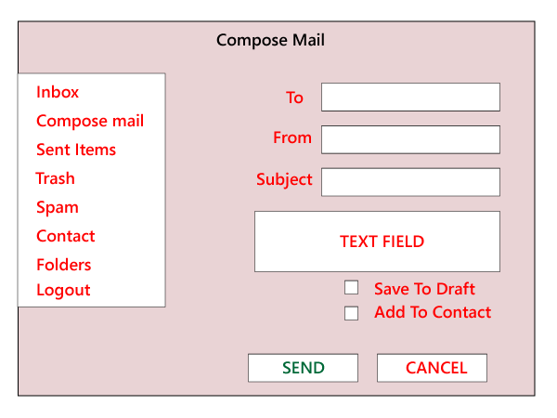
First, we login as P users and click on the Compose mail and performing the functional testing for the specific components.
Now we click on the Send and also check for Save Drafts.
After that, we send a mail to Q and verify in the Send Items folder of P to check if the send mail is there.
Now, we will log out as P and login as Q and move to the Inbox and verify that if the mail has reached.

Slide 13
Reason Behind Integration Testing

Slide 14
Although all modules of software application already tested in unit testing, errors still exist due to the following reasons:
Each module is designed by individual software developer whose programming logic may differ from developers of other modules so; integration testing becomes essential to determine the working of software modules.
To check the interaction of software modules with the database whether it is an erroneous or not.

Slide 15
Requirements can be changed or enhanced at the time of module development. These new requirements may not be tested at the level of unit testing hence integration testing becomes mandatory.
Incompatibility between modules of software could create errors.
To test hardware's compatibility with software.
If exception handling is inadequate between modules, it can create bugs.

Slide 16
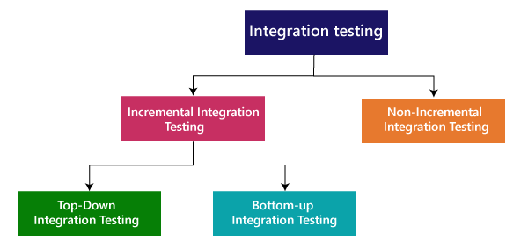
Integration Testing Techniques, Types

Slide 17
Types of Integration Testing

Slide 18
Incremental Approach
In the Incremental Approach, modules are added in ascending order one by one or according to need.
The selected modules must be logically related. Generally, two or more than two modules are added and tested to determine the correctness of functions.
The process continues until the successful testing of all the modules.
There is a strong relationship between the dependent modules.
Suppose we take two or more modules and verify that the data flow between them is working fine. If it is, then add more modules and test again.

Slide 19
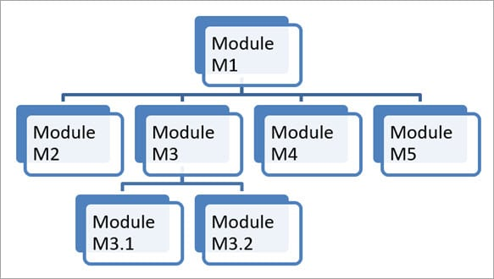

Slide 20
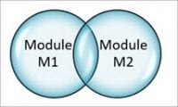

Slide 21


Slide 22
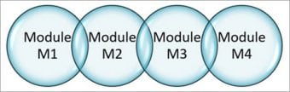

Slide 23
Black Box Testing
State Transition technique
Decision Table Technique
Boundary Value Analysis
All-pairs Testing
Cause and Effect Graph
Equivalence Partitioning
Error Guessing
White Box Testing
Data flow testing
Control Flow Testing
Branch Coverage Testing
Decision Coverage Testing

Slide 24
Objective of Incremental Test
To ensure that different modules work together successfully after integration
Identify the defects earlier and in each phase. This gives developers an edge to identify where the problem is. Like if testing after M1 and M2 are integrated is successful but when M3 is added, the test fails; this will help the developer in segregating the issue
Issues can be fixed in early phase without much rework and in less cost

Slide 25
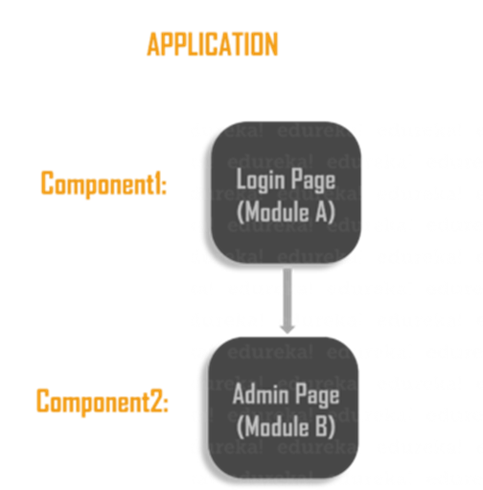
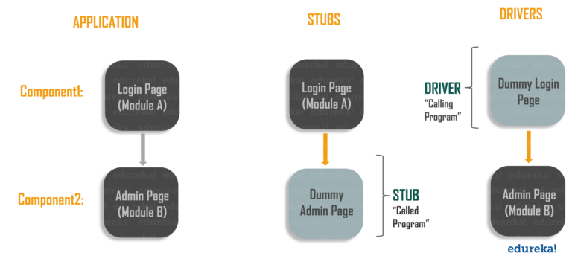
Stubs and Drivers
While testing, sometimes we face a situation where some of the modules are still under development. These modules for testing purpose are replaced with some dummy programs. These dummy programs are called stubs and drivers.

Slide 26
Stubs
Stubs are used in Top-down testing approach and are known as “called programs”.
Stubs help simulate the interface between lower lever modules which are not available or developed.

Slide 27
Drivers
Drivers are used in Bottom-up testing approach and are known as “calling programs”.
Drivers help simulate the interface between top level modules which are not developed or available.

Slide 28
Top Down
As the name suggests, testing takes place from top to bottom, i.e., from the central module to sub module. Modules framing the top layer of application are tested first.
This approach follows the structural flow of the application under testing. Unavailable or not developed modules or components are substituted by stubs.

Slide 29
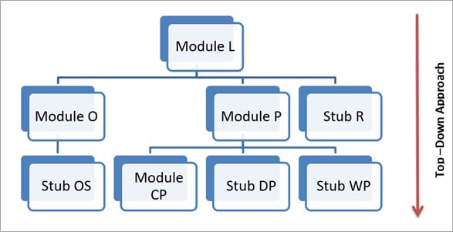
Let’s understand this with an example:

Slide 30
Module: Website Login aka L
Module: Order aka O
Module Order Summary aka OS (Not yet developed)
Module: Payment aka P
Module Cash Payment aka CP
Module Debit/Credit Payment aka DP (Not yet developed)
Module Wallet Payment aka WP (Not yet developed)
Module: Reporting aka R (Not yet developed)

Slide 31
Top down Incremental Integration Testing Approach
Following test cases will be derived:
Test Case1: Module L and Module O will be integrated and tested
Test Case2: Module L, O and P will be integrated and tested
Test Case3: Module L, O, P and R will be integrated and tested.

Slide 32
Merits of Top-down Methodology
Early exposure of architecture defects
It outlines the working of an application as a whole in early stages and helps in early disclosure of design defects
Main control points are tested early
De-Merits of Top-down Methodology
Significant modules are tested late in cycle
It is very challenging to write test conditions
A stub is not a perfect implementation of related Module. It just simulates the data flow between two modules

Slide 33
Bottom-up
In this approach, testing takes place from bottom to top, i.e., modules at bottom layer are integrated and tested first and then sequentially other modules are integrated as we move up.
Unavailable or not developed modules are replaced by drivers.

Slide 34
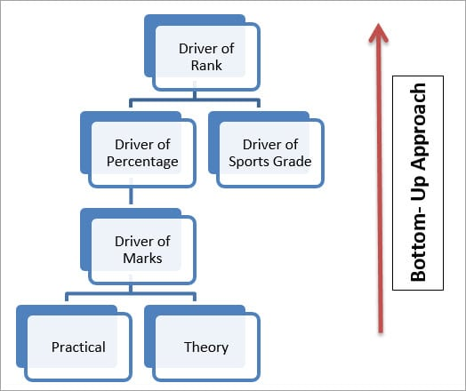
Modules Rank, Marks, Percentage and Sports Grade are not yet developed so they will be substituted with related Driver

Slide 35
Bottom up Incremental Integration testing approach
Following test cases will be derived:
Test Case1: Unit testing of module Practical and Theory
Test Case2: Integration and testing of Modules Marks-Practical-theory
Test Case3: Integration and testing of Modules Percentage-Marks-Practical-Theory
Test Case4: Unit testing of Module Sports Grade
Test Case5: Integration and testing of Modules Rank-Sports Grade-Percentage-Marks-Practical-Theory

Slide 36
Merits of Bottom-up Methodology
This methodology is very useful for applications where bottom up design model is used
It’s easier to create test conditions in bottom up approach
To start testing at the bottom level of hierarchy means testing of critical modules or functionality at an early stage. This helps in early discovery of errors
Interface defects are detected at early stage
De-merits of Bottom-up Methodology
Drivers are more difficult to write than stub
Design defects are caught in the later stage
In this approach, we do not have working application until the last module is build
Driver is not a complete implementation of related Module. It just simulates the data flow between two modules.

Slide 37
Sandwich Testing
This approach is a hybrid of top-down and bottom-up methodology.
Stub and drivers are used for incomplete or not developed modules.

Slide 38
Testing Approach
A middle layer is identified from which bottom-up and top-down testing are done. This middle layer is also known as target layer
Target layer is identified as per Heuristic approach, i.e., select a layer which allows minimal use of Stubs and drivers
Top-down testing starts from middle layer and moves downwards towards lower level modules. This layer below middle layer is known as Bottom layer
Bottom-up testing also starts from middle layer and move up towards top layer modules. This layer above middle layer is known as Top layer
With use of stubs and drivers, user interface and functions of lower level modules are tested respectively
In the end, only middle layer is left for the execution of the final test

Slide 39
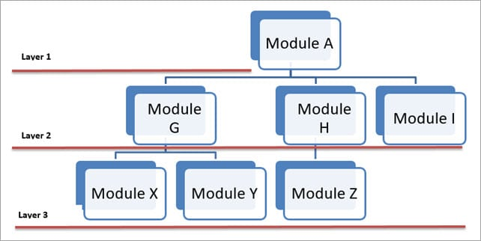
Test Case2: Test A, G, H and I
Test Case3: Test G, X, and Y
Test Case4: Test H and Z
Test Case5: Test A, G, H, I, X, Y, and Z
Test Case1: Test A, X, Y, and Z individually – where Test A comes under Top layer test and Test X, Y and Z comes under Bottom layer tests

Slide 40
Merits of Sandwich Testing Methodology
It is very beneficial for a big project which has various sub-projects
Top-down and bottom-up testing methodology can run side by side
De-merits of Sandwich Testing Methodology
Before module unification, subsystems and their interfaces are not tested thoroughly
Higher cost due to involvement of both top-down and bottom-up testing methodology
This type of testing is not advised for a system where modules are highly inter-dependent

Slide 41
Big Bang Integration Testing
Big Bang testing is a type of testing where all the components are integrated together at once and then tested as a whole.
Individual modules are not integrated until and unless all the modules are ready.
All the modules are integrated without performing any integration testing and then it’s executed to know whether all the integrated modules are working fine or not.

Slide 42
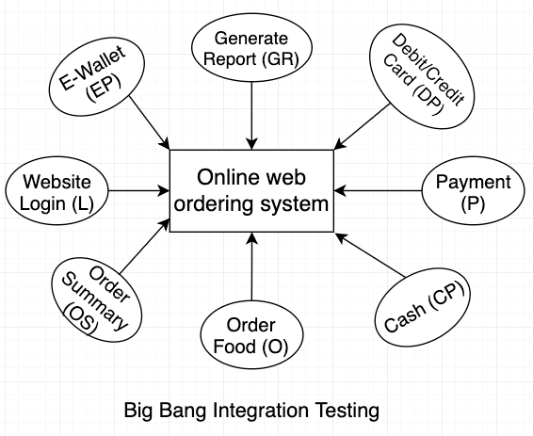

Slide 43
Advantages of Big Bang Integration Testing:
Consists of completed and checked modules
It is extremely suitable for small systems.
The main advantage is that everything is finished before integration testing starts.
Disadvantages of Big Bang Testing:
There is a high chance of missing some critical defects, which might pop up in the production environment.
It is very difficult to cover all the cases for integration testing.
Causes delay as tester needs to wait till all modules are integrated.

Slide 44
GUI application Integration Test
How we can imply integration testing in Black box technique?
A web application is a multitier application.
There is a front end which is visible to the user, a middle layer which has business logic, some more middle layer which does some validations, integrate some third party APIs etc., then there is the back layer which is the database.

Slide 45
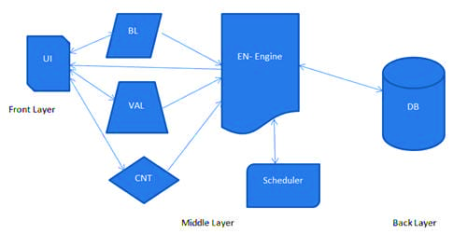
I am the owner of an advertising company and I post ads on different websites. At the end of the month, I want to see how many people saw my ads and how many people clicked on my ads. I need a report for my ads displayed and I charge accordingly to my clients.
The architecture

Slide 46
UI – User Interface module, which is visible to the end user, where all the inputs are given.
BL – Is the Business Logic module, which has all the all the calculations and business specific methods.
VAL – Is the Validation module, which has all the validations of the correctness of the input.
CNT – Is the content module which has all the static contents, specific to the inputs entered by the user. These contents are displayed in the reports.
EN – Is the Engine module, this module reads all the data that comes from BL, VAL and CNT module and extracts the SQL query and triggers it to the database.
Scheduler – Is a module which schedules all the reports based on the user selection (monthly, quarterly, semiannually & annually)
DB – Is the Database.

Slide 47
Integration testing, in this case, will focus on the flow of data between the modules.
The questions here are:
How the BL, VAL and the CNT module will read and interpret ate the data entered in the UI module?
Is BL, VAL and CNT module receiving the correct data from UI?
In which format the data from BL, VAL and CNT is transferred to the EQ module?
How will the EQ read the data and extract the query?
Is the query extracted correctly?
Is the Scheduler getting the correct data for reports?
Is the result set received by the EN, from the database is correct and as expected?
Is EN able to send the response back to the BL, VAL and CNT module?
Is UI module able to read the data and display it appropriately to the interface?

Slide 48
In the real world, the communication of data is done in an XML format. So whatever data the user enters in the UI, it gets converted into an XML format.
In our scenario,
the data entered in the UI module gets converted into XML file which is interpreted by the 3 modules BL, VAL and CNT.
The EN module reads the resultant XML file generated by the 3 modules and extracts the SQL from it and queries into the database.
The EN module also receives the result set and converts it into an XML file and returns it back to the UI module which converts the results in user readable form and displays it.

Slide 49

So where Integration testing does comes into the picture?
Well, testing whether the information/data is flowing correctly or not will be your integration testing, which in this case would be validating the XML files.
Are the XML files generated correctly?
Do they have the correct data?
Are the data is being transferred correctly from one module to another?
All these things will be tested as part of Integration testing.

Slide 50
Few other sample test conditions can be as follows:
Are the menu options generating the correct window?
Are the windows able to invoke the window under test?
For every window, identify the function calls for the window that the application should allow.
Identify all calls from the window to other features that the application should allow
Identify reversible calls: closing a called window should return to the calling window.
Identify irreversible calls: calling windows closes before called window appears.
Test the different ways of executing calls to another window e.g. – menus, buttons, keywords.

Slide 51
Steps to Kick off Integration Tests
Understand the architecture of your application.
Identify the modules
Understand what each module does
Understand how the data is transferred from one module to another.
Understand how the data is entered and received into the system ( entry point and exit point of the application)
Segregate the application to suit your testing needs.
Identify and create the test conditions
Take one condition at a time and write down the test cases.

Slide 52
Entry/Exit Criteria for Integration Testing
Entry Criteria:
Integration test plan document is signed off and approved.
Integration test cases have been prepared.
Test data has been created.
Unit testing of developed modules/Components is complete.
All the critical and high Priority defects are closed.
The test environment is set up for integration.
Exit Criteria:
All the integration test cases have been executed.
No critical and Priority P1 & P2 defects are opened.
Test Report has been prepared

Slide 53
Integration Test Cases
Integration test cases focus mainly on the
interface between the modules,
integrated links,
data transfer between the modules as modules/components that are already unit tested i.e. the functionality and the other testing aspects have already been covered.
The main idea is to test if integrating two working modules works as expected when integrated

Slide 54
Example Integration Test cases
Integration Test cases for Linkedin application will include:
Verifying the interface link between the login page and the home page i.e. when a user enters the credentials and logs it should be directed to the homepage.
Verifying the interface link between the home page and the profile page i.e. profile page should open up.
Verify the interface link between the network page and your connection pages i.e. clicking accept button on Invitations of the network page should show the accepted invitation in your connection page once clicked.
Verify the interface link between the Notification pages and say congrats button i.e. clicking say congrats button should direct towards the new message window.

Slide 55
Is Integration a White box or Black box Technique?

Slide 56
Integration Testing Tools
There are several tools available for this testing.
Rational Integration Tester
Protractor
Steam
TESSY

Slide 57
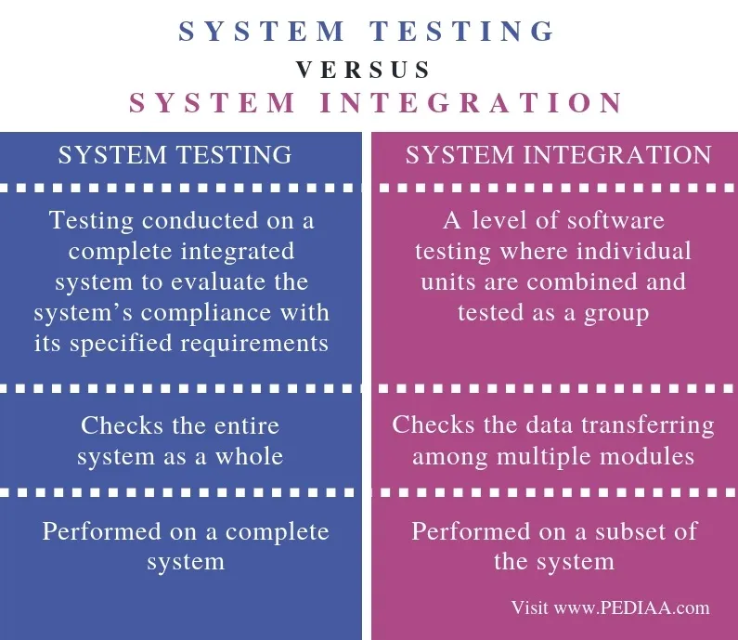
Difference between Integration Testing & System Testing
Integration testing
one or two modules which are unit tested are integrated to test and verification is done to verify if the integrated modules work as expected or not.
System testing
the system as a whole is tested i.e. all the modules/components are integrated together to verify whether the system works as expected and no issues occur because of the integrated modules.

